Slide 1
Welcome to the WPN WA International Women’s Day Breakfast 2023
#crackingthecode: innovation for a gender equal future

Slide 2
MC Address

Slide 3
Welcome to Country

Slide 4
Housekeeping
Presentation of the WPN WA Award 2023
Keynote, Nat Medhurst
Raffle prize winners drawn
Closing remarks

Slide 5
Cracking the Code: Innovation for a Gender Equal Future
Cracking the Code highlights the role that bold, transformative ideas, inclusive technologies, and accessible education can play in combatting discrimination and the marginalisation of women globally.

Slide 6
Our 2023 Charity, Zonta House
Zonta House Refuge Association is a specialist service that provides safety, essential relief and support to women who have experienced family and domestic violence.

Slide 7
Zonta House Charity Raffle
Generous prizes from our donors include a signed 2022 West Coast Eagles guernsey, Como Treasury Gift Voucher Oh Hey WA Gift Voucher and much more!

Slide 8
Women in Planning Network Award 2023
Proudly sponsored by Shape Urban, this Award recognises a WA female professional who has made an outstanding contribution to the planning profession; and demonstrated commitment to diversity within the planning profession and related built environment sectors.

Slide 9
A Word From Our Award Sponsor, Shape Urban
Anna Kelderman, Director, Shape Urban

Slide 10
WPN WA Award Winner 2022

Slide 11
WPN WA Award 2023 Convenor and Judging Panel

Slide 12
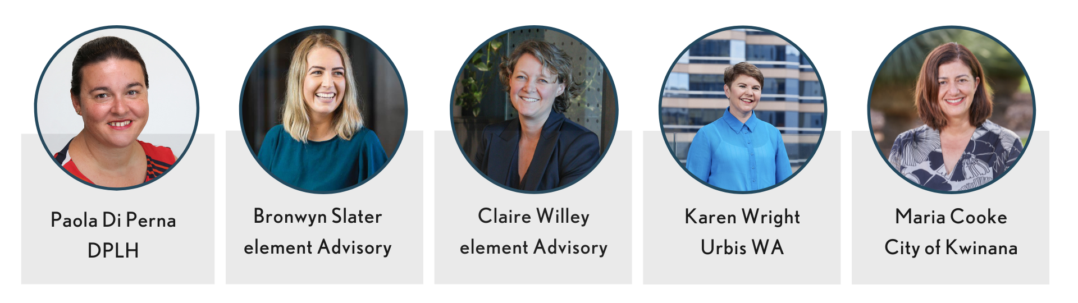
WPN WA Award Nominees 2023

Slide 14
WPN WA Award Commendation

Slide 16
WPN WA Award Winners

Slide 17
Keynote: Nat Medhurst

Slide 18
Charity Raffle Draw

Slide 19
Thank you

Slide 20
Next event

Slide 21
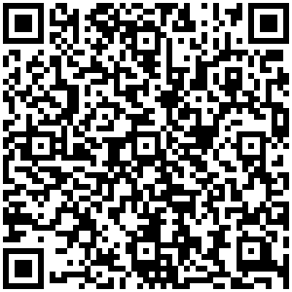
Member Survey
Help us to deliver diverse, exciting and relevant events and activities that connect, inspire and support you by filling in our survey and win a prize!

